Slide 1







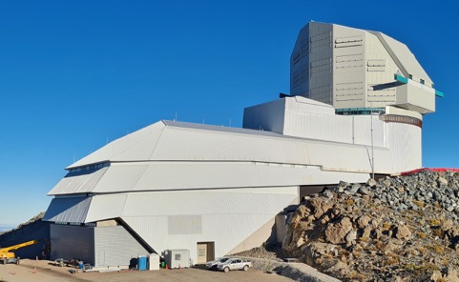



NEURAL PROCESSES
A. Kovačević¹,
LINCC Tech Talks, November 10, 2022
Notes:
Hello My name is Angelica Kovacevic, I am a lead of SER-SAG inkind directable software contribution. On behalf of
SER-SAG team I will present report on key technical aspects of the Conditional neural process module that is integral to the our inkind contribution time domain periodicity mining pipeline for AGN and stellar light curves, which can complement and help other LSST pipelines in frequency domain. We Thank you to LINCC, Neven and Alex who are leading Organizers of LINCC Tech Talks for giving us the opportunity to present this report.. This presentation is not intended to promote specific algorithms, but rather to demonstrate how our in-kind contribution team applies nonparametric modeling to light curves which will be found in LSST data products.
The SER-SAG team is currently experimenting with these algorithms and welcomes feedback from the LSST community.

Slide 2
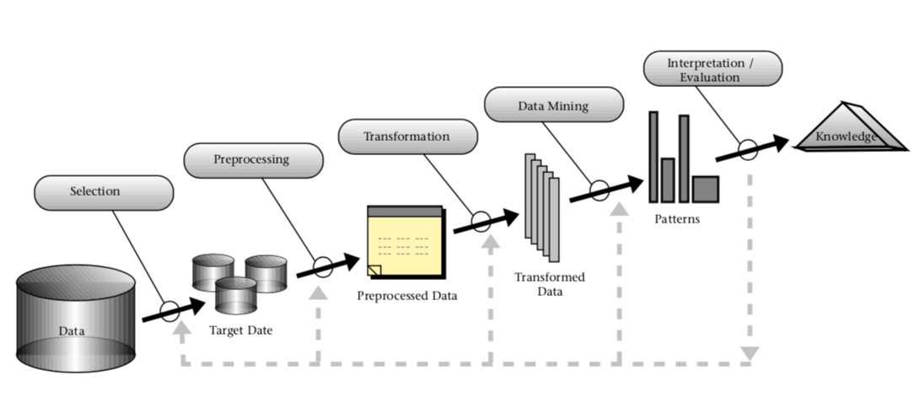
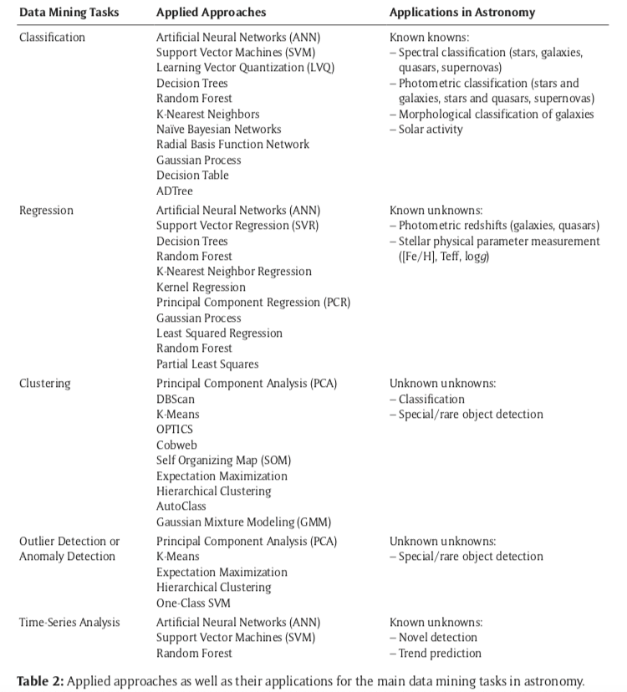
LIGHT CURVE MODELING WITHIN THE CONTEXT OF KDD (KDD= Knowledge discovery in databases)
An Overview of the Steps That Compose the KDD Process [Fayyad et al., 1996]
list some of the main present/ future facilities which will observe AGN
Radio: LOFAR, ASKAP (Australia)-3x10^7 AGN, MeerKAT (South Africa), e-MERLIN (UK), APERTIF (The Netherlands), SKA
IR: JWST (NASA/ESA), Tokyo Atacama Observatory (Japan), Euclid (ESA/NASA)-10^6 AGN, WFIRST (NASA), SPICA;
Optical/NIR: Zwicky Transient Facility (USA), LSST- 10^6 AGN, and the giant telescopes namely GMT, TMT, ELT, MSE;
X-ray: eROSITA, XIPE, and Athena;
γ-ray: Cherenkov Telescope Array and the Large High Altitude Air Shower Observatory (China).
Zhang and Zhao 2015 : Astronomy in the Big Data Era
Notes:
. Data mining, the application of specific algorithms to discover rare or previously unknown types of object or phenomenon, is a particular step in the process of Knowledge discovery in databases (KDD) [KDD is the process of extracting useful knowledge from data]. KDD is inherently interactive and iterative, as shown in Figure. Common KDD functions are classification, cluster analysis, and regression. As Big data and non-parametric modelling constitute two of the most important foci of modern
machine learning research, In this work we investigate algorithms for Conditional Neural Processes. CNPs were created as an expansion of Generative Query Networks (GQNs) in sense to extend GQN training regime to tasks such as regression and classification.
Unlike most standard neural networks, CNPs learn to approximate a distribution over functions rather than a single function. As a result, even when given a small number of observations, CNPs are adaptable and can approximate any function from this distribution. Which should be on the level of model agnostic machine learning approach imitating human way of learning. We have learnt a lot about AGN since the discovery of the first quasar in 1963. However, there are still many open questions in AGN research, some of them quite important, and for us is the quest for detecting binary quasar candidates. We will soon have plenty of data to tackle these and other open issues. Here I simply list some of the main facilities, which we are or will be having at our disposal. In terms of AGN science these facilities will open up entire new regions of parameter space, especially with regard to sensitivity and number of sources.the future of AGN studies is very bright and we will soon be flooded with amazing new data. To take full advantage of them we need to ask the right questions and use the most appropriate and efficient tools.

Slide 3
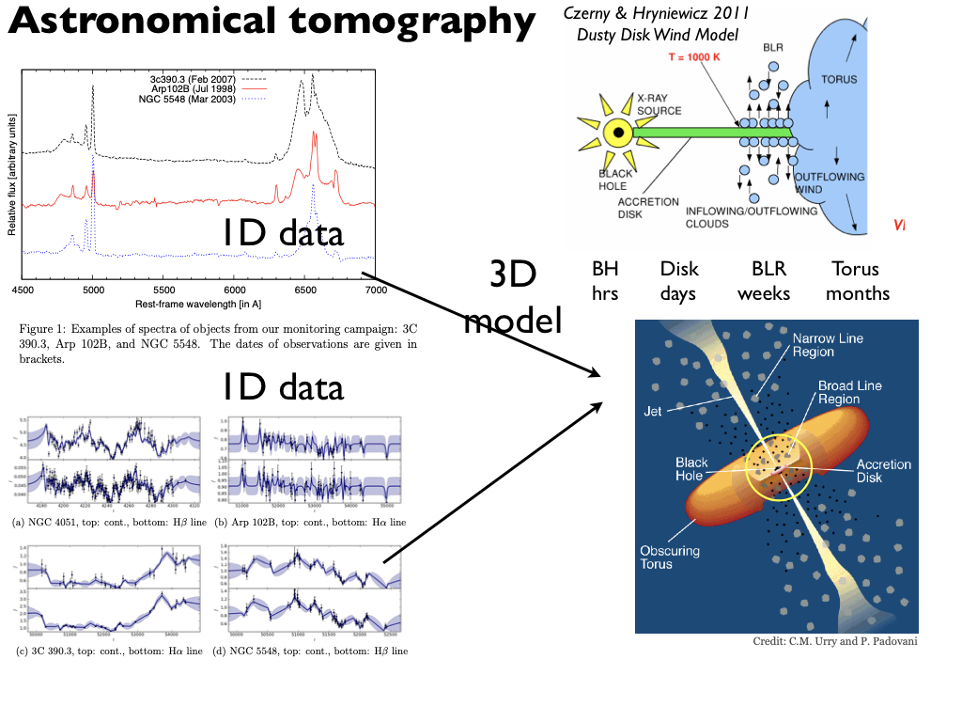
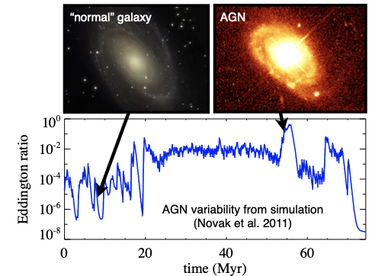
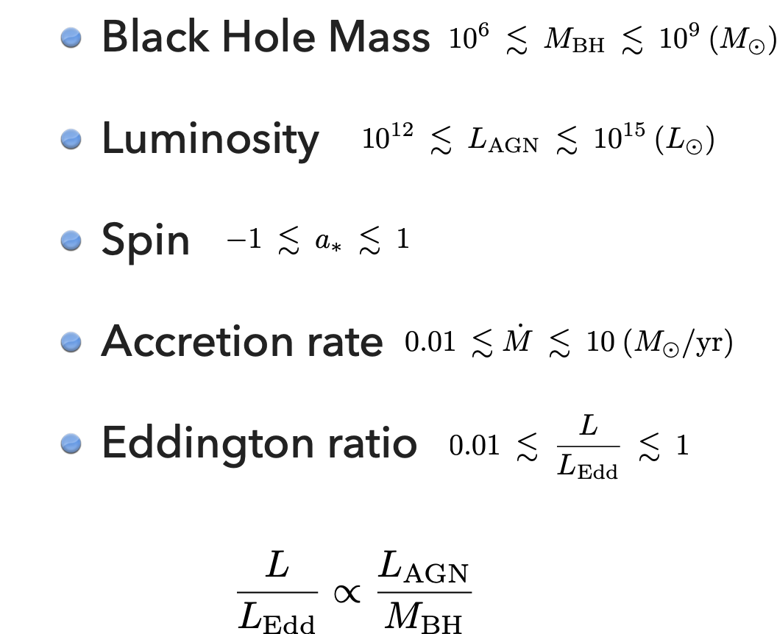
Horne +03
Figure reproduced from Hickox et al. (2014) in Padovani et al 2017
Notes:
Einstein thought nature would protect us from the formation of black holes. To the contrary, nature makes them in abundance. Relativity and quantum mechanics appear to suggest that the universe should be a boring place. It should be dark, lethal and lifeless. However quite fascinanting phenomena
As implicit in the name, AGN are stronger emitters than the nuclei of “normal” galaxies. This “extra” component is unrelated to the nuclear fusion powering stars and is now universally accepted to be connected instead to the presence of an actively accreting central supermassive (& 10^6 Msun) black hole (SMBH). AGN have many interesting properties. These include: (1) very high luminosities (up to Lbol ≈ 1048 erg s−1 ), which make them the most powerful non-explosive sources in the Universe and therefore visible up to very high redshifts (currently z = 7.1: Mortlock et al., 2011); (2) small emitting regions in most bands, of the order of a milliparsec, as inferred from their rapid variability (e.g. Ulrich, Maraschi, & Urry, 1997), implying high energy densities; (3) strong evolution of their luminosity functions (LFs; e.g. Merloni & Heinz, 2013); (4) detectable emission covering the whole electromagnetic spectrum. The latter property means that AGN are being discovered in all spectral bands. Different methods are employed in different bands to identify these sources but, most importantly, the various wavelength regimes provide different windows on AGN physics. Namely, the infrared (IR) band is mostly sensitive to obscuring material and dust, the optical/ultraviolet(UV) band is related to emission from the accretion disk, while the X-ray band traces the emission of a (putative) corona. γ-ray and (high flux density) radio samples, on the other hand, preferentially select AGN emitting strong non-thermal (jet [or associated lobe] related) radiation (see Fig. 1)1 . The surface densities of AGN also vary strongly across the electromagnetic spectrum due to a complex mix of physical processes, selection effects, and technological limitations. As there is explosion of AGN zoo taxonomy, Reality is much simpler, however, as we know that most of these seemingly different classes are due to changes in only a small number of parameters, namely: orientation (e.g. Antonucci, 1993; Urry & Padovani, 1995; Netzer, 2015), accretion rate (e.g. Heckman & Best, 2014), the presence (or absence) of strong jets (e.g. Padovani, 2016), and possibly the host galaxy and the environment
Today we are already exploring the micro-arcsec structure of black hole accretion flows through echo tomography experiments. Tomography is an indirect imaging technique that recovers an image from measurements of projections of that image. Tomography is analogous to interferometry, except that the measurements are of projections rather than fourier components of the image. Echo mapping employs time-resolved spectrophotometry to record spectral variations in which detailed information on spatial and kinematic structure is coded as time delays and Doppler shifts. Current models of AGN spectral energy distributions include optical to X-ray emission from the accretion
disk, infrared emission from a dusty molecular torus encircling and from some viewing angles obscuring the disk,
and relativistically beamed radio to X-ray emission from jets. Emission lines arise from reprocessing of X-ray . and EUV radiation in two kinematically-distinct regions, the broad line region (BLR) with V ∼ 104 km s−1 , and the narrow-line region (NLR) with V < 103 km s−1 . The NLR, resolved by HST, has a bi-polar morphology interpreted as wide cones of ionising radiation emerging from the unresolved nucleus. The accretion disk and BLR are unresolved, but these regions vary on timescales of days to months in response to erratic changes in ionising radiation from regions still closer to the black hole. Light travel time within the system produces observable time delays, providing indirect information on the size and structure of the disk and BLR, which make these regions accessible to echo tomography

Slide 4
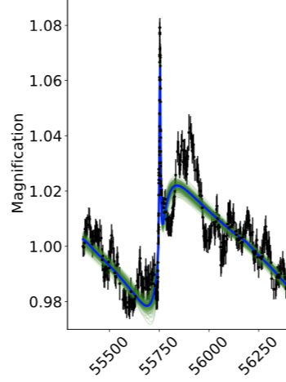
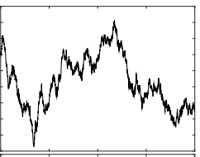
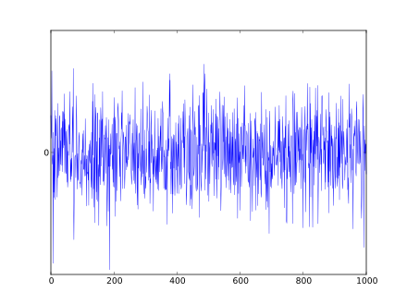
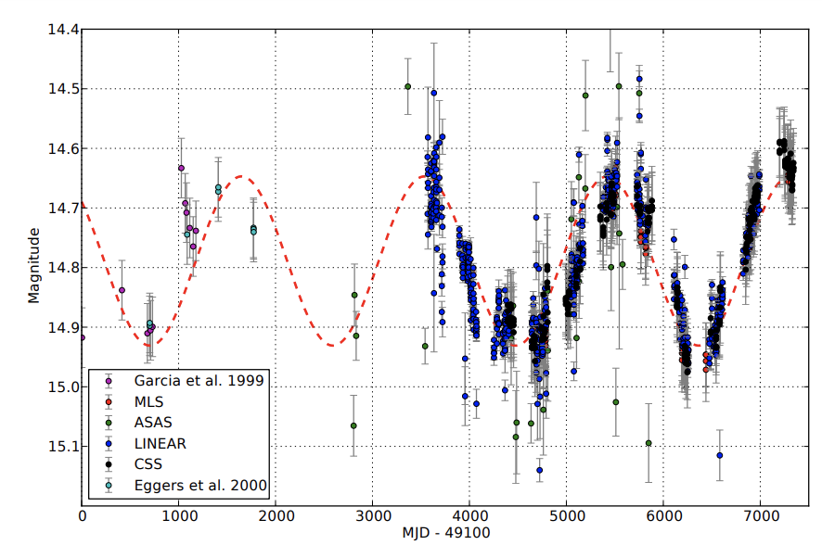
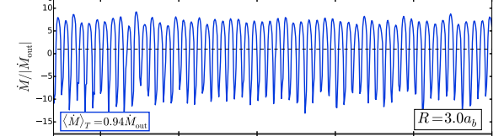
VARIETY OF SIGNALS IN AGN EMISSION LIGHT CURVES
Observed Flux =Steady mean X ( Doppler boost) X (Gravitational) X (Red noise) + Photometric noise
flux microlensing
FLUX
Optical light curve for Spikey,
Hu et al 2020
TIME
Observed Flux= Steady mean X (time variable accretion) X (Red noise) + Photometric noise
flux
Graham et al 2015
Munoz& Lai 2016
FLUX
TIME
Notes:
periodic variability may be imprinted by the orbital
motion of a sub-pc separation SMBHB via time variable accretion (e.g., Artymowicz & Lubow 1994; Hayasaki et al. 2007; MacFadyen & Milosavljevic´ 2008; Cuadra et al. 2009; Shi et al. 2012;
D’Orazio et al. 2013; Farris et al. 2014; D’Orazio et al. 2015a; Shi
& Krolik 2015; Muñoz & Lai 2016; Bowen et al. 2019), or by the
relativistic Doppler boost (D’Orazio et al. 2015b). It has also been
suggested that binary self-lensing, which would occur if the accretion flow from one black hole was gravitationally lensed by its
partner, could serve as a signature of SMBHBs (D’Orazio & Di
Stefano 2018, hereafter D18)
In addition to a steady mean flux F0, we consider four components in our light curve model: the Doppler boost, gravitational microlensing, stochastic noise described by the damped random walk
(DRW) model, and photometric noise,
Relativistic Doppler boosting will likely dominate the photometric variability for unequal mass-binaries and for orbits that are relatively close to edgeon (𝑖 = 90◦), (D’Orazio et al. 2016); In addition to Doppler boost variability, in
unequal mass binaries with orbits close to edge-on, periodic selflensing flares may also be observed (D’Orazio & Di Stefano 2018;
Hu et al. 2020).
As for periodic accretion
The binary perturbs the circumbinary disk leading to periodic leakage of gas into the cavity (MacFadyen & Milosavljević 2008; D’Orazio et al. 2013), which may be translated to periodic brightness fluctuations of the binary. Periodic variations may be observed at the orbital period of the binary or at a few times the orbital period of the binary, depending on the binary’s mass ratio (D’Orazio et al. 2013; Farris et al. 2014; Noble et al. 2021), and the eccentricity (Miranda et al. 2017) discussed below. The periodicity coincides with the orbital period for unequal-mass binaries, whereas for relatively equal-mass binaries, the dominant periodic component is expected at a several (∼ 5 − 8) times the orbital period (D’Orazio et al. 2013; Farris et al. 2014; Miranda et al. 2017). This timescale corresponds to the orbital period of a hotspot (over-density) formed at the edge of the circumbinary disk (Shi et al. 2012; Farris et al. 2014). The exact mass-ratio where the transition occurs is still uncertain and depends on the simulation setup (D’Orazio et al. 2013; Farris et al. 2014; Muñoz et al. 2020).
Beyond periodic accretion, relativistic Doppler boosting can also produce periodic photometric variability (D’Orazio et al. 2015b; Tang et al. 2018). For compact, milli-parsec binaries, the SMBHs (and thus the mini-disks around them) move at a fraction of the speed of light, and effects of special relativity are inevitable. For instance, the secondary mini-disk – which is typically more luminous and the one moving faster – will appear brighter when it is moving towards the observer and dimmer when it is moving away. Relativistic Doppler boosting will likely dominate the photometric variability for unequal mass-binaries and for orbits that are relatively close to edgeon (𝑖 = 90◦ ). Doppler boosting can produce significant periodicity, even if the rest-frame luminosity of the mini-disks is constant, which

Slide 5
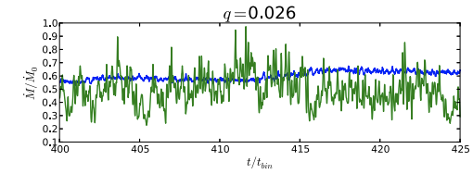
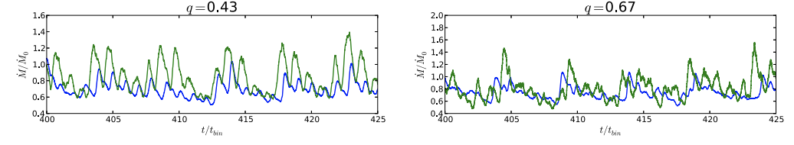
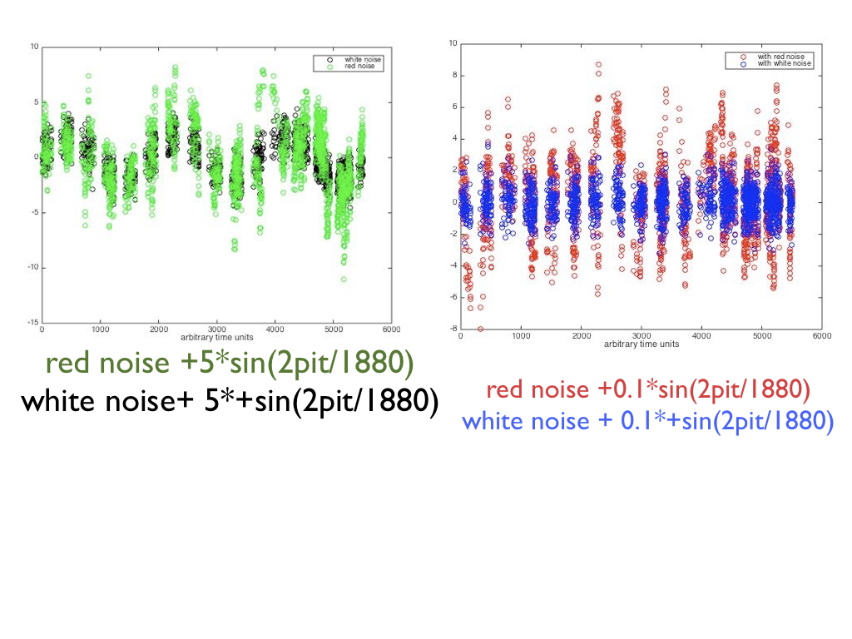
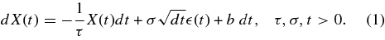
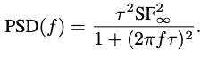
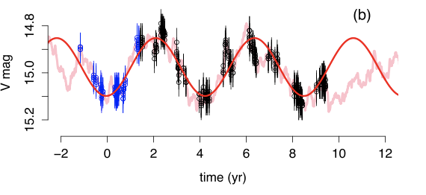
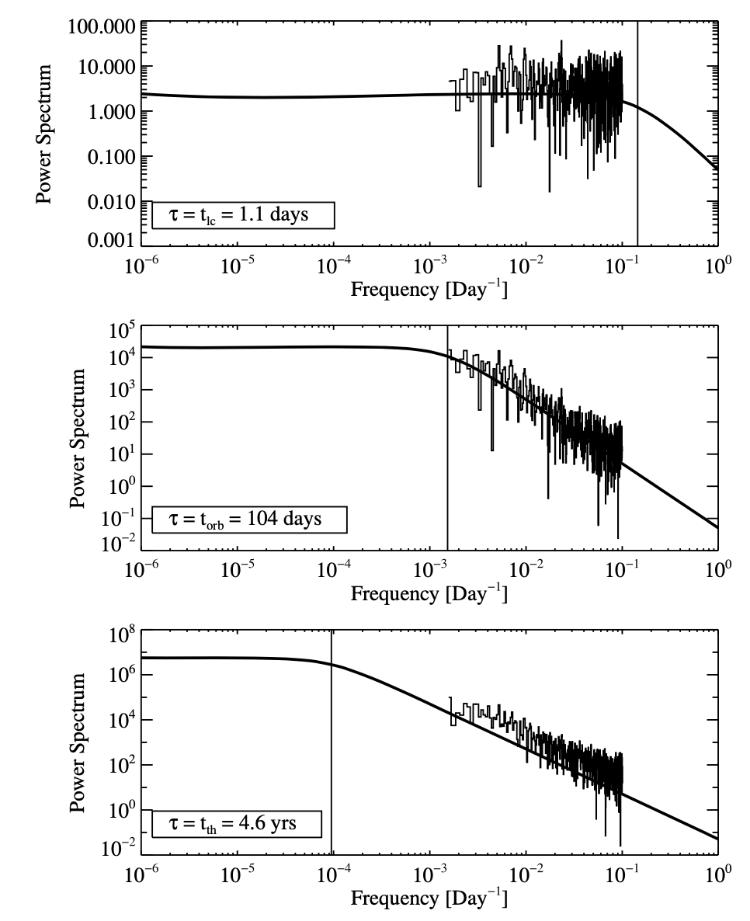
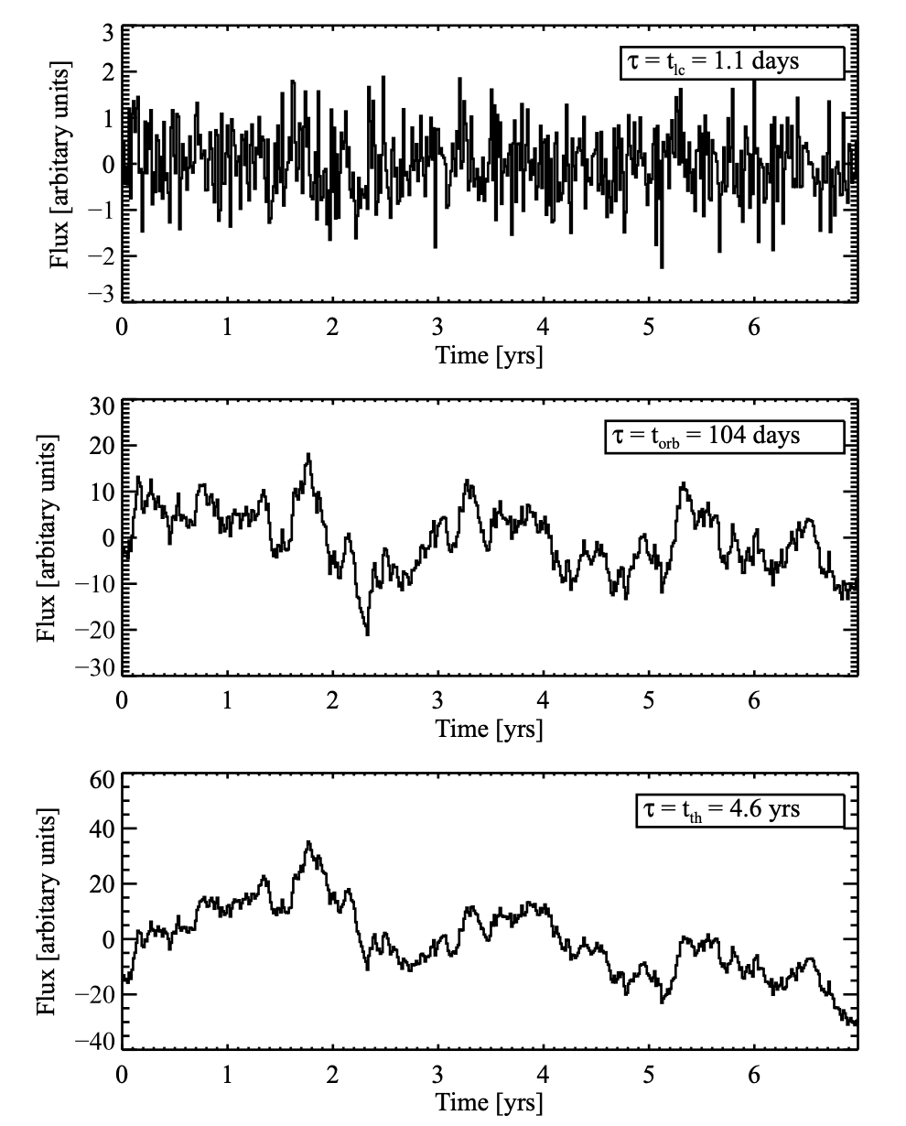
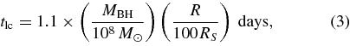
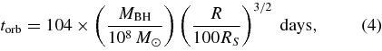
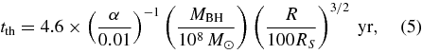
VARIETY OF SIGNALS IN AGN EMISSION LIGHT CURVES
Burst model (fig. 9 of Farris et al. 2014)
Periodicity signal immersed in red noise
The power spectral density (PSD) for the DRW is (Kelly et al 2009)
Red Noise mimics periodicity (fig. 1 of Vaughan et al 2016)
accretion disk thermal timescale.
light crossing
time scale
Fourier transform
the gas orbital timescale
accretion disk
thermal timescale.
Kelly et al 2009
Notes:
The other competing model for oscillatory signal is a more bursty, quasi-periodic variability model predicted by hydrodynamic simulations of circumbinary accretion discs by Faris et al 2009. In the simulations, significant periodicity in the accretion rates emerges only for q ≳0.1, where the binary torques are large enough to excite eccentricity in the inner cavity and create an overdense lump. The passing BHs interact with the overdense lump, producing periodicity in the accretion rate.
https://academic.oup.com/mnras/article/500/3/4025/5920624
https://iopscience.iop.org/article/10.1088/0004-637X/783/2/134/pdf
Thus the power spectrum decreases for variations shorter than τ_{DRW} (i.e. ‘red’ at higher variation-frequencies), but approaches a constant value for longer time-scales (i.e. ‘white’ at lower frequencies). In this context, the most important feature of red-noise spectra is their natural tendency to produce coherent excursions from the mean at longer time-scales. These excursions can easily resemble order unity cycles of sinusoidal variations (like Doppler boosting) or one-off peaks (like lensing flares). In red-noise regimes of parameter space, multiple complete cycles, repeated flares, or external constraints are often needed to confirm signals.Kelly et al directly model the quasar optical light curves as a stochastic process, in contrast to previous work based on more traditional Fourier (i.e., spectral) techniques. Our method allows us to describe quasar light curves with three free parameters: a characteristic timescale, amplitude of short-timescale variability, and the mean value of the light curve.
It is tempting to associate τ with a characteristic timescale, such as the time required for diffusion to smooth out local accretion rate perturbations, and σ to represent the variability resulting from local random deviations in the accretion disk structure, such as caused by turbulence and other random MHD effects.
The increased amount of variation on long timescales with increasing τ is apparent. In addition, because tlc is shorter than the time sampling, the first simulated light curve is only sampling frequencies on the flat part of the power spectrum, giving it the appearance of white noise. In contrast, the two simulated light curves with the longest timescales are sampled on the 1/f2 part of the power spectrum, giving them more of a "red noise" appearance.

Slide 6
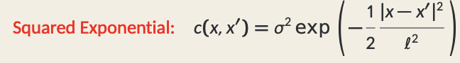
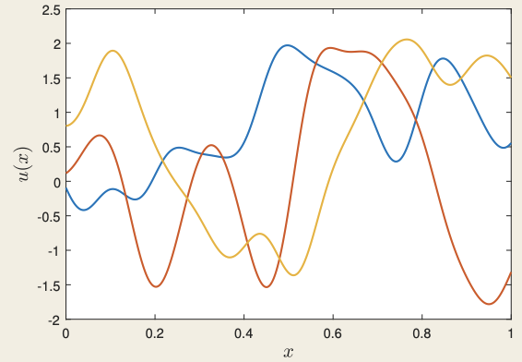
Gaussian Processes Definition I
• Let X be a separable Banach space. A random variable u : Ω → X is called a Gaussian random variable on X if ℓ(u) is a Gaussian random variable on R for all bounded linear ℓ : X → R.
– If X is Hilbert, then this is a direct generalization of the definition for R^n , by the Riesz representation theorem.
• If X is a space of functions on D ⊆ R^d , we will say that u is a Gaussian process on D.
• We may equivalently say that u is a Gaussian process on D if (u(x1), . . . , u(xk)) is a Gaussian random variable on R k for any finite collection of points {x1 , . . . , xk} ⊆ D.
• We define the mean m : D → R and covariance function c : D × D → R of a Gaussian process u on D by m(x) = E(u(x)), c(x, x 0 ) = E(u(x) − m(x))(u(x 0 ) − m(x 0 )), and write u ∼ GP(m(x), c(x, x 0 )).
Gaussian Processes Definition II
• If (X,〈·, ·〉) is a Hilbert space, we may also define the mean m ∈ X and covariance operator C : X → X of u by m = E(u), C = E(u − m) ⊗ (u − m) where the expression for C means that 〈φ, Cψ〉 = E〈φ, u − m〉〈ψ, u − m〉 for all φ, ψ ∈ X. We write u ∼ N(m, C).
• In the case u ∼ GP(m(x), c(x, x 0 )) and X = L 2 (D), we have (Cψ)(x) = ∫︁ D c(x, x 0 )ψ(x 0 ) dx 0 for all ψ ∈ X.
• The properties of the covariance function/operator determine the properties of samples, such as regularity, length-scale, stationarity, isotropy.
• We will say that a Gaussian process is Stationary if c(x, x 0 ) = h(x − x 0 ), Isotropic if c(x, x 0 ) = h(|x − x 0 |)
Notes:
The Damped Random Walk (DRW) model has emerged as the simplest Gaussian random process model that can fit the optical light curves of quasars reasonably well (e.g., Kelly et al. 2009; Kozłowski et al. 2010; MacLeod et al. 2010). Deviations from the DRW model have been reported (e.g., Mushotzky et al. 2011; Zu et al. 2013; Kasliwal et al. 2015; Guo et al. 2017), although some of these claims are likely impacted by the limited duration of the light curve in the DRW fit (e.g., Kozłowski 2017). More complex Gaussian random process models, such as the continuous auto-regressive moving-average (CARMA; Kelly et al. 2014) models, can accommodate a broader range of PSD shapes, and improve the fits provided that the light curve quality is sufficiently high.
What is a Gaussian Process? – A type of stochastic processes indexed by a spatial domain D ⊆ R d . – Equivalently, a type of probability distributions on a space of functions, e.g. C 0 (D).
MaybeviewedascontinuousapproximationstoBayesianneuralnetworks
Currently, kernel methods and deep neural networks are two of the most remarkable machine learning methodologies. Recent years have witnessed lots of works on the connection between these two methodologies. Lee et al. (2018) pointed out that randomly initializing parameters of an infinitely wide network gives rise to a Gaussian process, which is referred as neural network Gaussian processes (NNGP). Due to the widespread attraction of this idea, the studies of NNGP have been scaled into more types of networks, such as attention-based models (Hron et al. 2020) and recurrent networks (Yang 2019). A Gaussian process is a classical non-parametric model. The equivalence between an infinitely wide fully-connected network and a Gaussian process has been established by Neal (1996); Lee et al. (2018). Given a fully-connected multi-layer network whose parameters are i.i.d. randomly initialized, the output of each neuron is an aggregation o
neurons in the preceding layer whose outputs are i.i.d. When the network width goes infinitely large, according to the Central Limit Theorem (Fischer 2010), the output of each neuron conforms to the Gaussian distribution. As a result, the output function expressed by the network is essentially a Gaussian process. The correspondence between neural networks and Gaussian processes allows the exact Bayesian inference using the neural network (Lee et al. 2018).

Slide 7
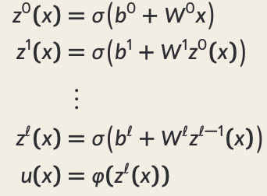
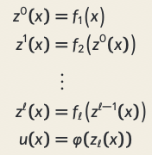
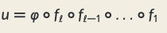
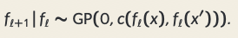
Deep Neural Network vs Deep Gaussian Processes
Deep Neural Network A feedforward deep neural network models the unknown function u : D → R as follows:
The matrices {Wk} and vectors {b k} are to be learned from observations y.
• If i.i.d. priors are placed on the unknown vectors/matrices, u still converges to a Gaussian process as n → ∞ (Lee et al, 2017; Matthews et al 2018).
• However, easier to train than shallow Gaussian process.
Deep Gaussian Process
A deep Gaussian process as in (Damianou, Lawrence, 2013)
replaces the neural networks σ(b k + Wk ·) with general functions fk:
Shallow Neural Network
A simple structure of dependence is to assume that a priori, we have a hierarchy given by the Markovian relation
Deep Gaussian Process
Notes:
Deep Neural Networks (DNNs) and Gaussian Processes (GPs)* are two highly expressive classes of supervised learning algorithms.
Mathematically, each layer of a neural network is given through computing the activation function,
𝜙(⋅)
ϕ(⋅), contingent on the previous layer, or the inputs. In this way the activation functions, are composed to generate more complex interactions than would be possible with any single layer.
One potential problem is that as the number of nodes in two adjacent layers increases, the number of parameters in the affine transformation between layers,
𝐖
W, increases. If there are
𝑘
𝑖−1
ki−1 nodes in one layer, and
𝑘
𝑖
ki nodes in the following, then that matrix contains
𝑘
𝑖
𝑘
𝑖−1
kiki−1 parameters, when we have layer widths in the 1000s that leads to millions of parameters.
One proposed solution is known as dropout wIncluding the low rank decomposition of 𝐖 in the neural network, we obtain a new mathematical form. Effectively, we are adding additional latent layers, 𝐳, in between each of the existing hidden layers. In a neural network these are sometimes known as bottleneck layers.here only a sub-set of the neural network is trained at each iteration.
Now if we replace each of these neural networks with a Gaussian process. This is equivalent to taking the limit as the width of each layer goes to infinity, while appropriately scaling down the outputs.
Mathematically, a deep Gaussian process can be seen as a composite multivariate function,
Or if we view it from the probabilistic perspective we can see that a deep Gaussian process is specifying a factorization of the joint density, the standard deep model takes the form of a Markov chain.
If the result of composing many functions together is simply another function, then why do we bother? The key point is that we can change the class of functions we are modeling by composing in this manner. A Gaussian process is specifying a prior over functions, and one with a number of elegant properties. For example, the derivative process (if it exists) of a Gaussian process is also Gaussian distributed. That makes it easy to assimilate, for example, derivative observations. But that also might raise some alarm bells. That implies that the marginal derivative distribution is also Gaussian distributed. If that’s the case, then it means that functions which occasionally exhibit very large derivatives are hard to model with a Gaussian process. For example, a function with jumps in.
A one off discontinuity is easy to model with a Gaussian process, or even multiple discontinuities. They can be introduced in the mean function, or independence can be forced between two covariance functions that apply in different areas of the input space. But in these cases we will need to specify the number of discontinuities and where they occur. In otherwords we need to parameterise the discontinuities. If we do not know the number of discontinuities and don’t wish to specify where they occur, i.e. if we want a non-parametric representation of discontinuities, then the standard Gaussian process doesn’t help.
The deep Gaussian process leads to non-Gaussian models, and non-Gaussian characteristics in the covariance function. In effect, what we are proposing is that we change the properties of the functions we are considering by composing stochastic processes. This is an approach to creating new stochastic processes from well known processes

Slide 8
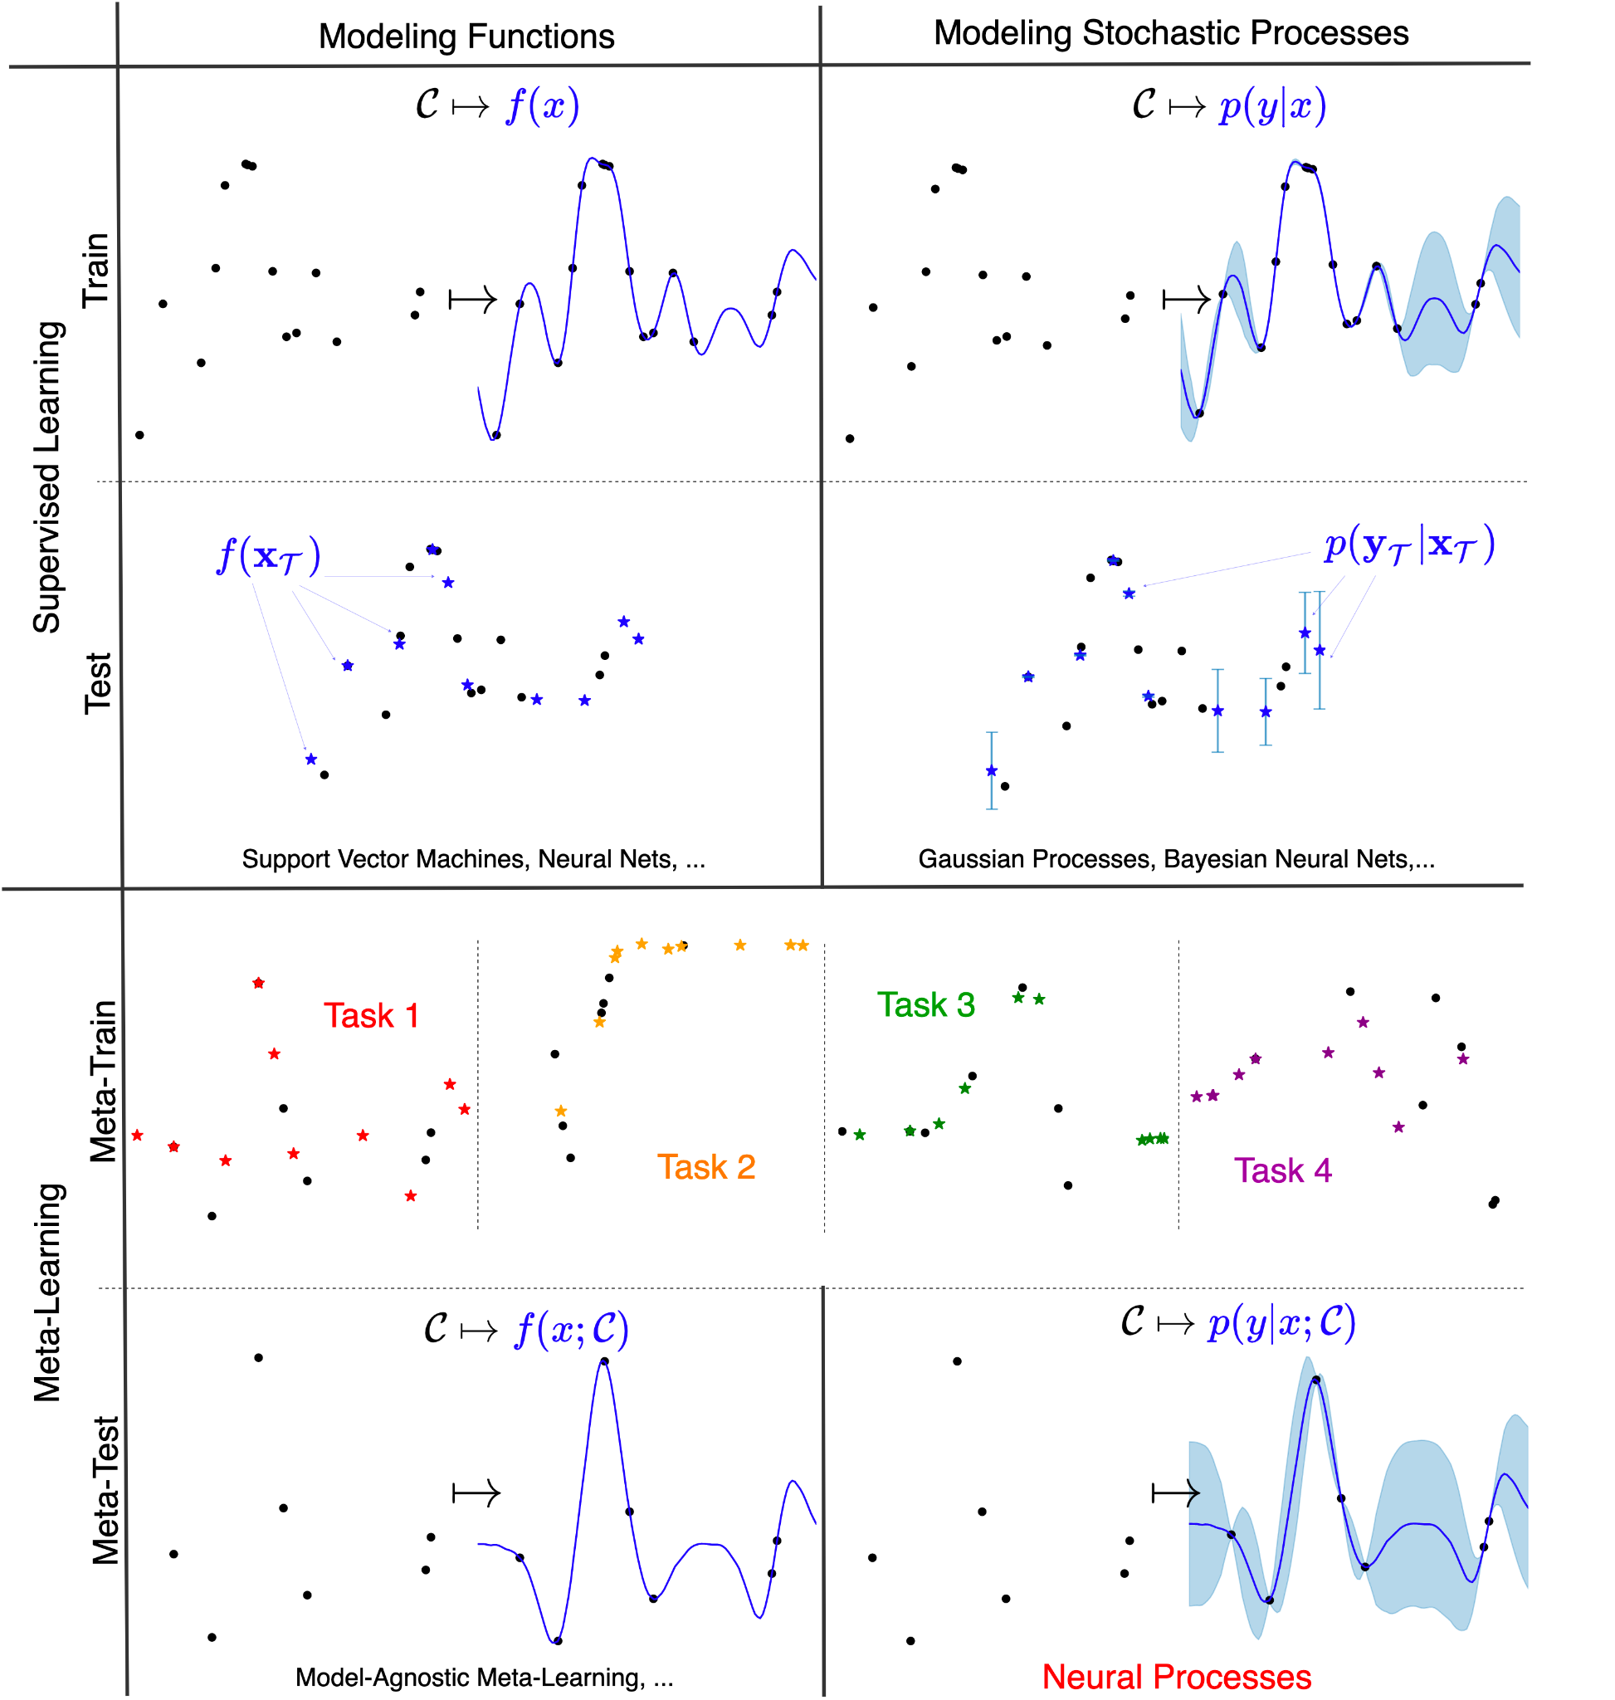
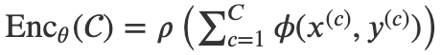
NEURAL PROCESSES
Matching networks
deep kernel learning
networks where each unit represents a different kernel (Sun et al., 2018).
neural networks whose weights are sampled using a GPs (Wilson et al., 2011)
NEURAL NETWORKS
GAUSSIAN
PROCESSES
NEURAL PROCESSES
DGP
ALGORITHM SPECTRUM
GENERAL SCHEME OF NEURAL PROCESS FAMILIES
1.NPs 𝑅,
2. the decoder, Dec𝜃, the map parametrizing the predictive distribution using the target input 𝑥(𝑡) and the encoding of ……
defined by NN
different sets for encoding define different members of Neural Processes Family
Dubois et al 2020
Notes:
We start by considering models that, lie on the spectrum between neural networks (NNs) and Gaussian processes (GPs). Algorithms on the NN end of the spectrum fit a single function that they learn from a very large amount of data directly. GPs on the other hand can represent a distribution over a family of functions, which is constrained by an assumption on the functional form of the covariance between two points.
On this spectrum from NNs to GPs, neural processes remain closer to the neural end than most of the models mentioned above. By giving up on the explicit definition of a kernel NPs lose some of the mathematical guarantees of GPs, but trade this off for data-driven ‘priors’ and computational efficiency.
Meta-learning models share the fundamental motivations Figure 3. 1-D function regression. The plots show samples of curves conditioned on an increasing number of context points (1, 10 and 100 in each row respectively). The true underlying curve is shown in black and the context points as black circles. Each column corresponds to a different example. With only one observation the variance away from that context point is high between the sampled curves. As the number of context points increases the sampled curves increasingly resemble the ground truth curve and the overall variance is reduced. of NPs as they shift workload from training time to test time
It is well known in the machine learning community that models must be trained with a large number of examples before meaningful predictions can be made for unseen data. However, we do not always have enough data available to cater to this need: A sufficient amount of data may be expensive or even impossible to acquire. Nevertheless, there are good reasons to believe that this is not an inherent issue of learning. Humans are known to excel at generalizing after seeing only a few samples
[2]
. It should, however, also be noted that humans do not learn novel concepts "in a vacuum"
[3]
but are based on a lot of prior knowledge having learned in other (similar) tasks. Enabling machine learning methods to achieve the same brings us a step closer to learning on humans' data- and energy-efficiency level. Consequently, we would require algorithms to do the following two things, already successfully implemented in humans:
(a) Obtaining as much prior knowledge about the world as possible and
(b) using that to generalize well on only a few samples.
(A) OBTAINING PRIOR KNOWLEDGE
While clearly, one sample is not enough for a model without prior knowledge, we can pretrain models on tasks that we assume to be similar to the target tasks. The idea in its core is to derive an inductive bias from a set of problem classes to perform better on other, newly encountered, problem-classes. This similarity assumption allows the model to collect meta-knowledge not obtained from a single task but the distribution of tasks. The learning of this meta-knowledge is called "meta-learning".
(B) GENERALIZATION ON A FEW SAMPLES
Achieving rapid convergence of machine learning models on a few samples is known as "few-shot learning". If you are presented with
N
samples and are expected to learn a classification problem with
M
classes, we speak of an
M
-way-
N
-shot problem
In contemporary meta-learning vocabulary, NPs and GPs can be seen to be methods for ‘few-shot function estimation’.
Given target inputs
𝐱
xT, what we need is not a single prediction
𝑓(
𝐱
;)
f(xT;C), but rather a distribution over predictions
𝑝(
𝐲
|
𝐱
;)
p(yT|xT;C). As long as these distributions are consistent with each other for different choices of
𝐱
xT, this is actually equivalent to specifying a distribution over functions,
𝑓(𝑥;)
f(x;C). In mathematics, this is known as a stochastic process (SP). Each predictor sampled from this distribution would represent a plausible interpolation of the data, and the diversity of the samples would reflect the uncertainty in our predictions — think back to Fig. 1. Hence, the NPF can be viewed as using neural networks to meta-learn a map from datasets to predictive stochastic processes. This is where the name Neural Process comes from, and is illustrated in the bottom right quadrant of Fig. 3.
NPs first map the entire context set to a representation,
𝑅
R, using an encoder
Enc
𝜃
Encθ. Specifically, the encoder is always going to be of form
Enc
𝜃
()=𝜌(
∑
𝐶
𝑐=1
𝜙(
𝑥
(𝑐)
,
𝑦
(𝑐)
))
Encθ(C)=ρ(∑c=1Cϕ(x(c),y(c))) for appropriate
𝜌
ρ and
𝜙
ϕ, which are defined using neural networks. The sum operation in the encoder is key as it ensures permutation invariance — due to the commutativity of the sum operation — and that the resulting
𝑅
R “lives” in the same space regardless of the number of context points
𝐶
C.
We will call the decoder,
Dec
𝜃
Decθ, the map parametrizing the predictive distribution using the target input
𝑥
(𝑡)
x(t) and the encoding of the context set —
𝑅
R in the case of the CNPF and (samples of)
𝑧
z for the LNPF. Typically the predictive distribution is Gaussian meaning that the decoder predicts a mean
𝜇
(𝑡)
μ(t) and a variance
𝜎
2(𝑡)
σ2(t).

Slide 9
NEURAL PROCESSES
Matching networks
deep kernel learning
networks where each unit represents a different kernel (Sun et al., 2018).
neural networks whose weights are sampled using a GPs (Wilson et al., 2011)
NEURAL NETWORKS
GAUSSIAN
PROCESSES
NEURAL PROCESSES
DGP
ALGORITHM SPECTRUM
GENERAL SCHEME OF NEURAL PROCESS FAMILIES
1.NPs 𝑅,
2. the decoder, Dec𝜃, the map parametrizing the predictive distribution using the target input 𝑥(𝑡) and the encoding of ……
defined by NN
different sets for encoding define different members of Neural Processes Family
Dubois et al 2020
Notes:
We start by considering models that, lie on the spectrum between neural networks (NNs) and Gaussian processes (GPs). Algorithms on the NN end of the spectrum fit a single function that they learn from a very large amount of data directly. GPs on the other hand can represent a distribution over a family of functions, which is constrained by an assumption on the functional form of the covariance between two points.
On this spectrum from NNs to GPs, neural processes remain closer to the neural end than most of the models mentioned above. By giving up on the explicit definition of a kernel NPs lose some of the mathematical guarantees of GPs, but trade this off for data-driven ‘priors’ and computational efficiency.
Meta-learning models share the fundamental motivations Figure 3. 1-D function regression. The plots show samples of curves conditioned on an increasing number of context points (1, 10 and 100 in each row respectively). The true underlying curve is shown in black and the context points as black circles. Each column corresponds to a different example. With only one observation the variance away from that context point is high between the sampled curves. As the number of context points increases the sampled curves increasingly resemble the ground truth curve and the overall variance is reduced. of NPs as they shift workload from training time to test time
It is well known in the machine learning community that models must be trained with a large number of examples before meaningful predictions can be made for unseen data. However, we do not always have enough data available to cater to this need: A sufficient amount of data may be expensive or even impossible to acquire. Nevertheless, there are good reasons to believe that this is not an inherent issue of learning. Humans are known to excel at generalizing after seeing only a few samples
[2]
. It should, however, also be noted that humans do not learn novel concepts "in a vacuum"
[3]
but are based on a lot of prior knowledge having learned in other (similar) tasks. Enabling machine learning methods to achieve the same brings us a step closer to learning on humans' data- and energy-efficiency level. Consequently, we would require algorithms to do the following two things, already successfully implemented in humans:
(a) Obtaining as much prior knowledge about the world as possible and
(b) using that to generalize well on only a few samples.
(A) OBTAINING PRIOR KNOWLEDGE
While clearly, one sample is not enough for a model without prior knowledge, we can pretrain models on tasks that we assume to be similar to the target tasks. The idea in its core is to derive an inductive bias from a set of problem classes to perform better on other, newly encountered, problem-classes. This similarity assumption allows the model to collect meta-knowledge not obtained from a single task but the distribution of tasks. The learning of this meta-knowledge is called "meta-learning".
(B) GENERALIZATION ON A FEW SAMPLES
Achieving rapid convergence of machine learning models on a few samples is known as "few-shot learning". If you are presented with
N
samples and are expected to learn a classification problem with
M
classes, we speak of an
M
-way-
N
-shot problem
In contemporary meta-learning vocabulary, NPs and GPs can be seen to be methods for ‘few-shot function estimation’.
Given target inputs
𝐱
xT, what we need is not a single prediction
𝑓(
𝐱
;)
f(xT;C), but rather a distribution over predictions
𝑝(
𝐲
|
𝐱
;)
p(yT|xT;C). As long as these distributions are consistent with each other for different choices of
𝐱
xT, this is actually equivalent to specifying a distribution over functions,
𝑓(𝑥;)
f(x;C). In mathematics, this is known as a stochastic process (SP). Each predictor sampled from this distribution would represent a plausible interpolation of the data, and the diversity of the samples would reflect the uncertainty in our predictions — think back to Fig. 1. Hence, the NPF can be viewed as using neural networks to meta-learn a map from datasets to predictive stochastic processes. This is where the name Neural Process comes from, and is illustrated in the bottom right quadrant of Fig. 3.
NPs first map the entire context set to a representation,
𝑅
R, using an encoder
Enc
𝜃
Encθ. Specifically, the encoder is always going to be of form
Enc
𝜃
()=𝜌(
∑
𝐶
𝑐=1
𝜙(
𝑥
(𝑐)
,
𝑦
(𝑐)
))
Encθ(C)=ρ(∑c=1Cϕ(x(c),y(c))) for appropriate
𝜌
ρ and
𝜙
ϕ, which are defined using neural networks. The sum operation in the encoder is key as it ensures permutation invariance — due to the commutativity of the sum operation — and that the resulting
𝑅
R “lives” in the same space regardless of the number of context points
𝐶
C.
We will call the decoder,
Dec
𝜃
Decθ, the map parametrizing the predictive distribution using the target input
𝑥
(𝑡)
x(t) and the encoding of the context set —
𝑅
R in the case of the CNPF and (samples of)
𝑧
z for the LNPF. Typically the predictive distribution is Gaussian meaning that the decoder predicts a mean
𝜇
(𝑡)
μ(t) and a variance
𝜎
2(𝑡)
σ2(t).

Slide 11
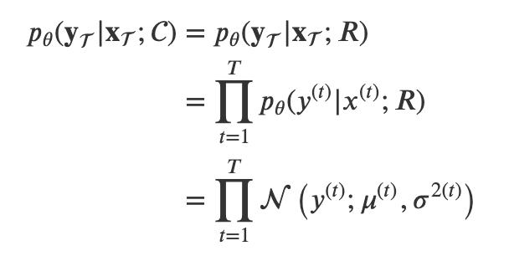
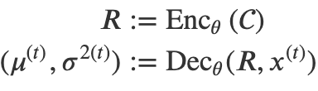
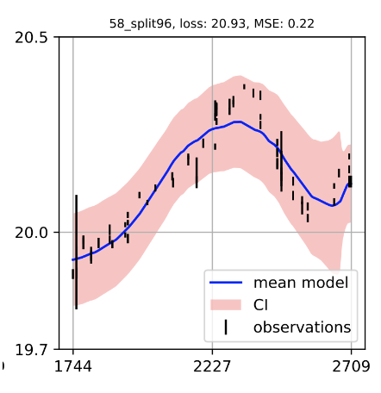
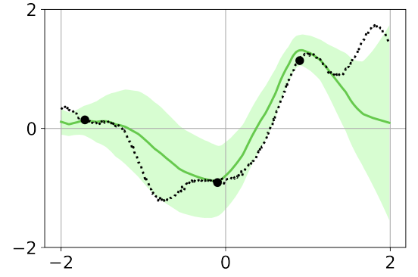
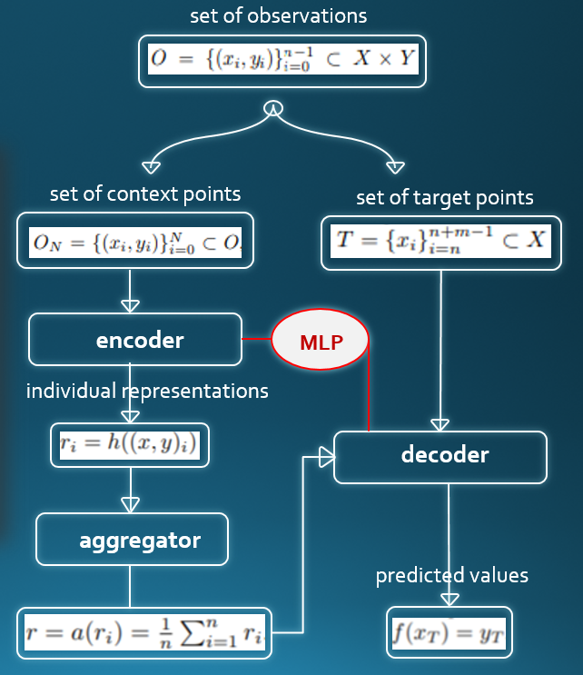
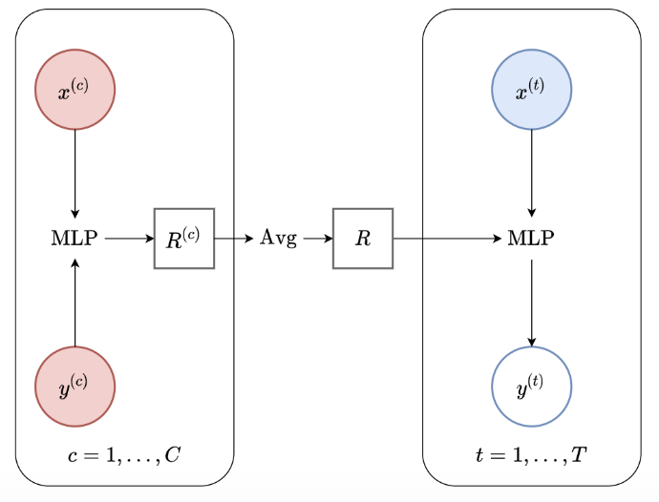
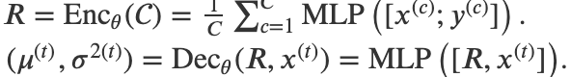
OVERVIEW OF CONDITIONAL NEURAL PROCESSES FAMILY
encoding
factorisation
encoding
decoding
Gaussianity
MEMBER OF NFP:CONDITIONAL NEURAL PROCESS
CNP modeling of GP generated data using 100 000 iterations. The light green area is the one sigma confidence interval. Black dots are context points. Black dotted line is the ground truth curve
Dubois et al 2020
Čvorović-Hajdinjak @al 2022
(Garnelo et al 2018)
Notes:
The key design choice for NPs is how to model the predictive distribution
𝑝
𝜃
(
𝐲
|
𝐱
;)
pθ(yT|xT;C). In particular, we require the predictive distributions to be consistent with each other for different
𝐱
xT, as discussed. A simple way to ensure this is to use a predictive distribution that is factorised conditioned on the context set.. In other words, conditioned on the context set
A typical (though not necessary) choice is to set each
𝑝
𝜃
(
𝑦
(𝑡)
|
𝑥
(𝑡)
;)
pθ(y(t)|x(t);C) to be a Gaussian density. Now, recall that one guiding principle of the NPF is to encode the context set
C into a global representation
𝑅
R, and then use a decoder to parametrise each
𝑝
𝜃
(
𝑦
(𝑡)
|
𝑥
(𝑡)
;)
pθ(y(t)|x(t);C).
C, the prediction at each target location is independent of predictions at other target locations.
The main idea of the Conditional Neural Process (CNP) [GRM+18] is to enforce permutation invariance of the encoder by first locally encoding each context input-output pair into
𝑅
(𝑐)
R(c), and then aggregating the local encodings into a global representation,
𝑅
R, of the context set using a commutative operation. Specifically, the local encoder is a feedforward multi-layer perceptron (MLP), while the aggregator is a mean pooling. The decoder is simply an MLP that takes as input the concatenation of the representation and the target input,
[𝑅;
𝑥
(𝑡)
]
[R;x(t)], and outputs a predictive mean
𝜇
(𝑡)
μ(t) and variance
𝜎
2(𝑡)
Note that the encoder is permutation invariant due to the commutativity of the sum operation, i.e., the order does not matter. Importantly, if the local encoder and the decoder were universal function approximators (think of “infinitely wide” MLP and unconstrained dimension of
𝑅
R) the CNP would essentially be able to predict any mean
𝜇
(𝑡)
μ(t) and variance
𝜎
2(𝑡)
σ2(t) thanks to the local encoder+aggregator

Slide 12
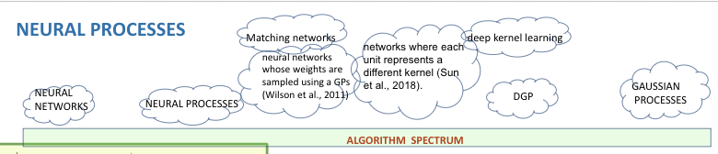
CONDITIONAL NEURAL PROCESSES MODELING OF QUASAR LIGHT CURVES
SER-SAG-1:Angelica Kovacevic, Dragana Ilic
example of modeling
GAIA quasar LC
encoding
encoding
factorisation
decoding
Gaussianity
CNP modeling of GP generated data using 100 000 iterations. The light green area is the one sigma confidence interval. Black dots are context points. Black dotted line is the ground truth curve
Dubois et al 2020
Čvorović-Hajdinjak @al 2022
(Garnelo et al 2018)
Notes:
The key design choice for NPs is how to model the predictive distribution
𝑝
𝜃
(
𝐲
|
𝐱
;)
pθ(yT|xT;C). In particular, we require the predictive distributions to be consistent with each other for different
𝐱
xT, as discussed. A simple way to ensure this is to use a predictive distribution that is factorised conditioned on the context set.. In other words, conditioned on the context set
A typical (though not necessary) choice is to set each
𝑝
𝜃
(
𝑦
(𝑡)
|
𝑥
(𝑡)
;)
pθ(y(t)|x(t);C) to be a Gaussian density. Now, recall that one guiding principle of the NPF is to encode the context set
C into a global representation
𝑅
R, and then use a decoder to parametrise each
𝑝
𝜃
(
𝑦
(𝑡)
|
𝑥
(𝑡)
;)
pθ(y(t)|x(t);C).
C, the prediction at each target location is independent of predictions at other target locations.
The main idea of the Conditional Neural Process (CNP) [GRM+18] is to enforce permutation invariance of the encoder by first locally encoding each context input-output pair into
𝑅
(𝑐)
R(c), and then aggregating the local encodings into a global representation,
𝑅
R, of the context set using a commutative operation. Specifically, the local encoder is a feedforward multi-layer perceptron (MLP), while the aggregator is a mean pooling. The decoder is simply an MLP that takes as input the concatenation of the representation and the target input,
[𝑅;
𝑥
(𝑡)
]
[R;x(t)], and outputs a predictive mean
𝜇
(𝑡)
μ(t) and variance
𝜎
2(𝑡)
Note that the encoder is permutation invariant due to the commutativity of the sum operation, i.e., the order does not matter. Importantly, if the local encoder and the decoder were universal function approximators (think of “infinitely wide” MLP and unconstrained dimension of
𝑅
R) the CNP would essentially be able to predict any mean
𝜇
(𝑡)
μ(t) and variance
𝜎
2(𝑡)
σ2(t) thanks to the local encoder+aggregator

Slide 13
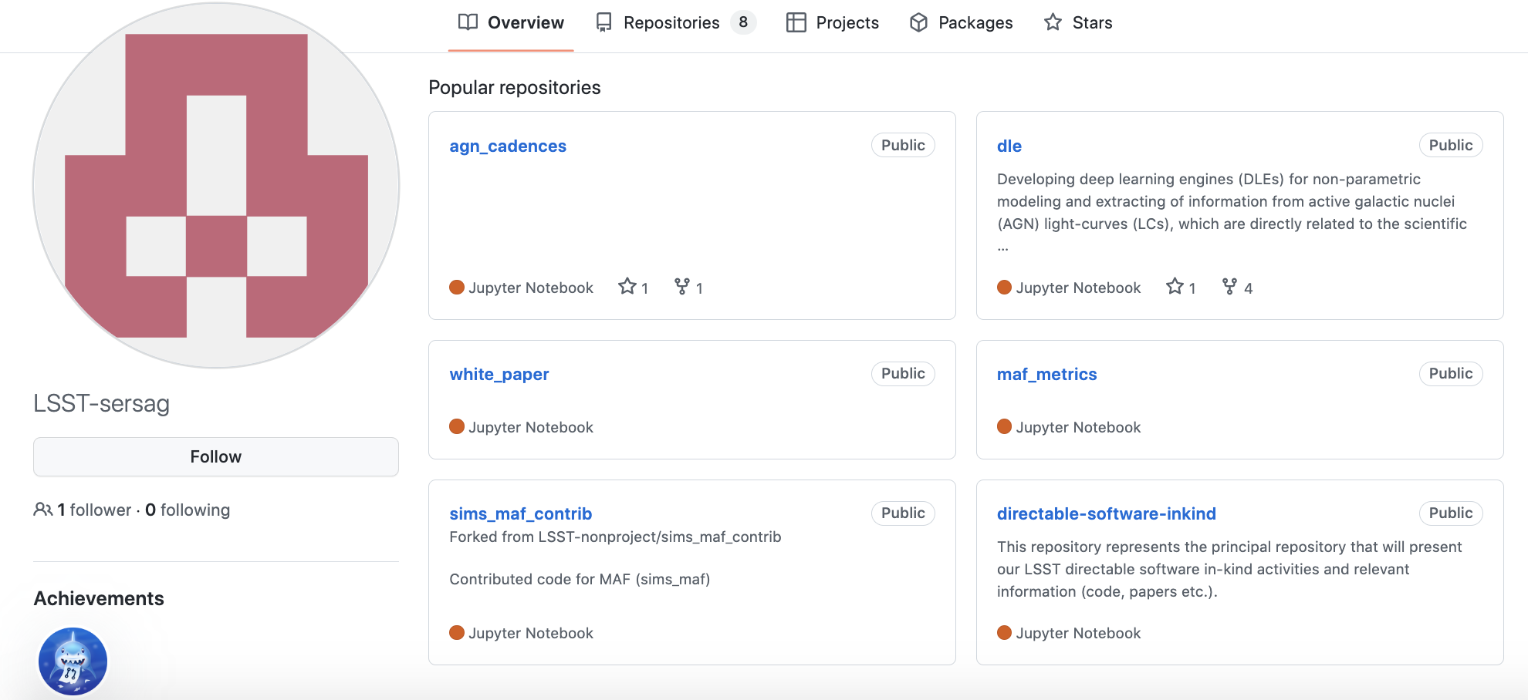
Conditional neural process (CNP) under the hood
CODE REPOSITORIUM @ https://github.com/LSST-sersag/cnp_agn/
CODE UPGRADED TO PYTORCH, REFACTORISED INTO ipynb by Nikola Andric Mitrovic
CNP_ARCHITECTURE.ipynb -model architecture
CNP_DATASETCLASS.ipynb- definition of dataset class and collate function
CNP_METRICS.ipynb- metrics: log prob loss i mse
CNP_TRAINING.ipynb -training and calculation of training and validation loss, and saving model in output/cnp_model.pth
CNP_PREDICTION.ipynb- upload of trained model so that prediction can be done anytime
LSST SER-SAG-1 TEAM github ID
BACK
Notes:
We need deep learning unit for light curves as some wavelets demands regularly cadenced light curve. For this purpose we use Conditional neural process, which scheme is seen on the right figure. Our CNP code is upgraded to pytorch and can be run on GPU.
The CNP code is refactored in different modules dedicated to uptaking any amount of data, modeling, training and outputing results.

Slide 14
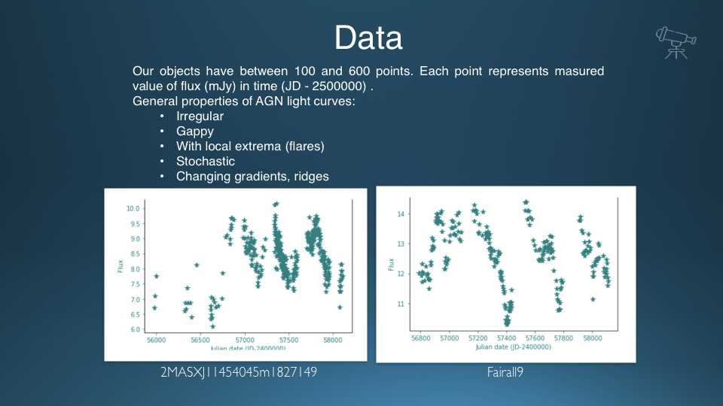
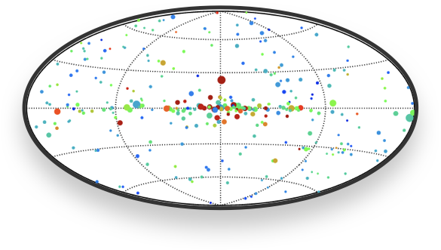
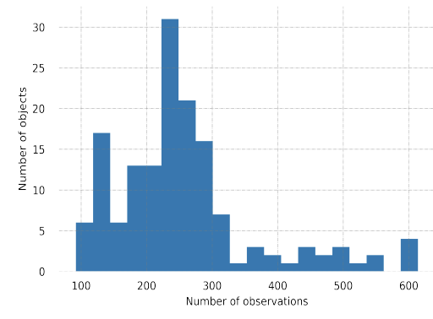
CNP examples
ASAS-SN data
taken from https://swift.gsfc.nasa.gov/results/bs9mon/
Čvorović-Hajdinjak @al 2021, 2022
Cvorovic-Hajdinjak et al 2021
150 AGN light curves detected in the first 9 months of all sky survey data collected by the BAT coded mask hard X-ray instrument from All Sky automated survey for supernove telescope
BACK
FWD
Notes:
The CNP algorithm has been trained and tested on a sample of 153 AGNs (see Figure 1), that were detected in the first nine months of the all sky survey by the Swift Burst Alert Telescope (9-Month BAT Survey1, Tueller et al., 2008). Their optical light curves were taken from the ASAS-SN database (Holoien et al., 2017), and they cover more than 2000 days. We have selected this set of AGN light curves for several reasons. They have a good representation of 80% sky coverage, and show particularities, such as flares, possible quasi-periodic oscillations, time gaps, and irregular cadence, enabling us to test our tool with challenging data sets. Our sample of AGN light curves is thus inhomogenous in many aspects. For example, observational coverage of each source is between 100 and 600 data points (Figure 2). The
distribution is bi-modal with large right tail, indicating unfavorable conditions for modeling For example, object Fairall 9 has 246 observations that cover 1318 days, with two big 100-day gaps. This example demonstrates irregular and unevenly clustered data. The observational time baseline for each object is about 2000 days which is significant for testing our tool on light curves with a substantial length.
CLICK NA CNP SLIKU KRIVE NEKOLIKO PUTA DA SE POKRENE; CNP are metalearners so that we could use them on different collection of objects. In the right we see results for modeling NGC 5548 Hb light curve after training CNP on 150 ASASSN Light curves. Also the CNP has been trained on 40000 ZTF light curves kindly provided by Paula Sanchez Saez
we can use neural networks to meta-learn a map from observed datasets to predictive stochastic processes. Meta-learning allows neural processes to incorporate data from many related tasks (e.g. many different objects) and the stochastic process framework allows the network to effectively represent uncertainty. In the right we see results for modeling NGC 5548 Hb light curve after training CNP on 150 ASASSN Light curves. Also the CNP has been trained on 40000 ZTF light curves kindly provided by Paula Sanchez Saez
A supervised learning algorithm can thus be seen as a map that takes datasets to a predictors
The idea of meta-learning is learning to learn, i.e., learning how to rapidly adapt to new supervised tasks. The key insight is that, as we just saw, a supervised learning algorithm is itself a function, because it maps datasets to predictors

Slide 15
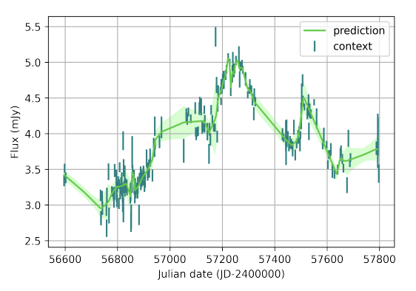
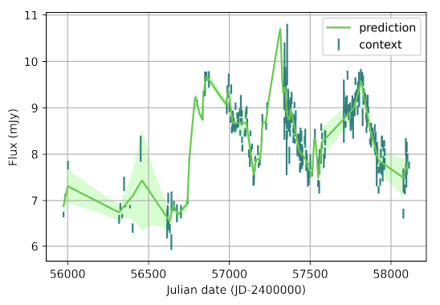
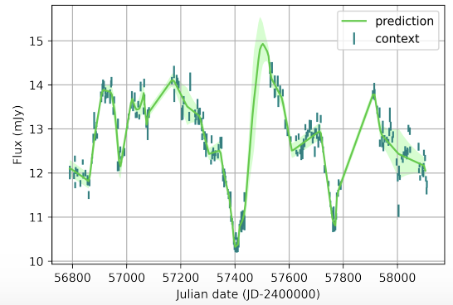
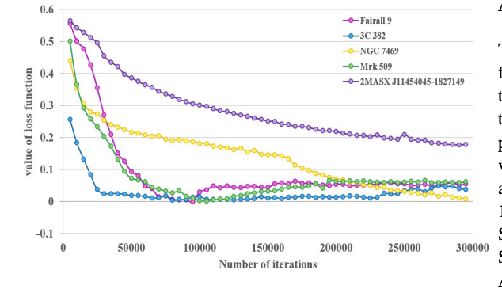
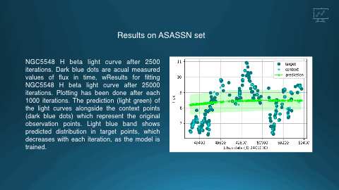
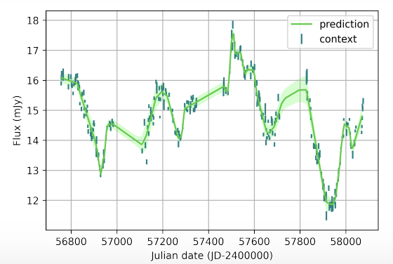
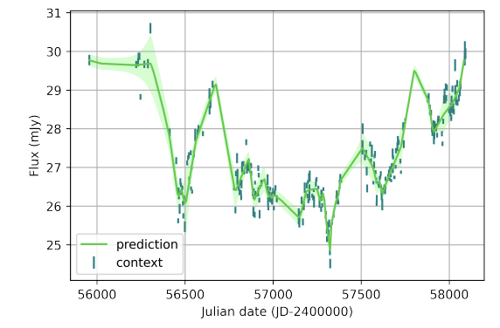
ASAS-SN data
Fairall 9
2MASX J11454045-1827149
3C 382
Comparison of CNP loss function values for
sample of objects
Mrk 509
NGC 7469
NGC 7469
NGC 5548
Čvorović-Hajdinjak @al 2021, 2022
Back
Notes:
NGC5548 H beta light curve after 2500 iterations. Dark blue dots are acual measured values of flux in time, wResults for fitting NGC5548 H beta light curve after 25000 iterations. Plotting has been done after each 1000 iterations. The prediction (light green) of the light curves alongside the context points (dark blue dots) which represent the original observation points. Light blue band shows predicted distribution in target points, which decreases with each iteration, as the model is trained.
shows how the loss function
changes during modeling light curves with 300 000 iterations.
It appears that the loss function sometimes reaches its mini-
mum very fast (after several thousand iterations), suggesting
that further training process is unnecessary and time of execu-
tion for this cases could be significantly shorter. In addition,

Slide 16
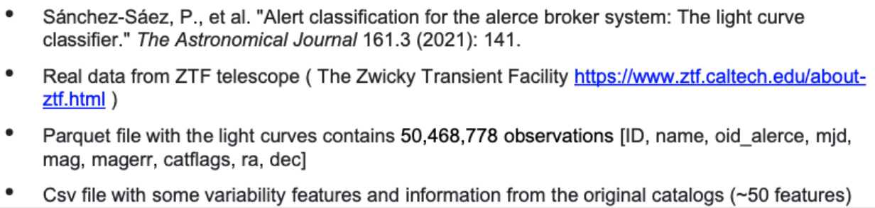


CNP examples
ZTF data
(I experiment) and ~120 000 quasars (II experiment)
Čvorović-Hajdinjak @al 2021, 2022
Cvorovic-Hajdinjak et al 2021
BACK
FWD
Notes:
The conditional neural process is trained on two large ZTF datasets consisiting of 40 000 and 120 000 objects, as well as on
small data set of ASASN data preselected according to expert criterions.
During this experiments we examined parameters influnecing training process as well as achieved acceleration of computing which is 10 times.
CLICK NA CNP SLIKU KRIVE NEKOLIKO PUTA DA SE POKRENE; CNP are metalearners so that we could use them on different collection of objects. In the right we see results for modeling NGC 5548 Hb light curve after training CNP on 150 ASASSN Light curves. Also the CNP has been trained on 40000 ZTF light curves kindly provided by Paula Sanchez Saez
we can use neural networks to meta-learn a map from observed datasets to predictive stochastic processes. Meta-learning allows neural processes to incorporate data from many related tasks (e.g. many different objects) and the stochastic process framework allows the network to effectively represent uncertainty. In the right we see results for modeling NGC 5548 Hb light curve after training CNP on 150 ASASSN Light curves. Also the CNP has been trained on 40000 ZTF light curves kindly provided by Paula Sanchez Saez
A supervised learning algorithm can thus be seen as a map that takes datasets to a predictors
The idea of meta-learning is learning to learn, i.e., learning how to rapidly adapt to new supervised tasks. The key insight is that, as we just saw, a supervised learning algorithm is itself a function, because it maps datasets to predictors

Slide 17


Slide 18


CNP model of a LC for CCF
in photo-reverberation mapping
NGC 4395 data by Edri @ al 2012
CNP solid line
Time (h)
Jankov @ al 2022
Time (h)
Notes:
CNP has been successfully used by Jankov et al as modeling tool of LC as a part of their automated procedure for photoreverberation mapping

Slide 19






Cooperation with CPG in-kind team
Kickstarter Leads:
SER-SAG: Sasa Simic, Luka Popovic, CPG: Lovro Palavesra, Tomislav Jurkic
CPG team M. Fatović, L. Palaversa et al 2022 submitted
investigation of short period (<300 days) binary QSO candidate;
example how 2D Hybrid method complement standard Fourier periodicity mining
DEEP GAUSSIAN MODEL
Notes:
We are thrilled that through LSST we have beuatiful opprotunity to coopearate with CPG thorugh the TVS SC....
and on the investigation of intresting binary quasar candidate

Slide 20
FUTURE/IN-PROGRESS WORK
-Attentive Latent Neural Process
-NP testing on LSST AGN Data Challenge set
-NP testing on AI Platform
-Exploitation of NP codes CPG IDAC “BURA”
in cooperation with IDAC Lead Tomislav Jurkic

Slide 21


Auxiliary Projects:
LSSTC Enabling science: Deep Learning Engine projects
DLE task 1 (DLE1):
Light Curve nonparametric modeling
(Conditional Neural Process)
DLE task 2 (DLE2): photometric reverberation mapping (PhotoRM)
Learned LC will enable us to improve time-lag determination as a goal of PhotoRM. periodicity, etc.
→ see Cvorovic-Hajdinjak et al., 2022, Conditional Neural Process for nonparametric modeling of active galactic nuclei light curves, Astronomische Nachrichten, Volume 343, Issue 1-2, article id. e210103
New tools for PhotoRM based on the formalism by Chelouche & Daniel (2012)
→ see Jankov et al. 2022, Photoreverberation mapping of quasars in the context of Legacy Survey of Space and Time observing strategies, Astronomische Nachrichten, Volume 343, Issue 1-2, article id. e210090
<number>
Notes:
We have different auxiliary projects. Thankfully to the support of LSSTC Enabling science our two phd students Cvorovic-Hajdinjak and Jankov contributed
to conditional neural process modules and photoreverberation mapping

Slide 22



DLE task 2 (DLE2): Photometric reverberation mapping (PhotoRM)
New python module (pyZDCF) that mirror ZDCF - available on PyPI from October 26th!
New tutorial on Astro Data Lab (available soon)
ADVERTISEMENT
Simple to use
Familiar interface
PhotoRM use case available in Astro Data Lab tutorial
At this moment, pyZDCF is available on Test PyPI: https://test.pypi.org/project/pyzdcf/
Notes:
And we also produced upgraded pyZDCF mirroring famous fortran ZDCF code of Tal Alexander for light curve cross correlation. our pyzdcf can handle large amount of data as we used sparse
matrix algebra for calculations. PyZDCF is announced on #agn_variablity slack channel already obtaining positive feedback from the community.

Slide 23




Auxiliary Projects:
SER-SAG Engagement with LSST Community
OPSIM EVALUATION
Andjelka B Kovačević, Dragana Ilić, Luka Č Popović, Viktor Radović, Isidora Jankov, Ilsang Yoon, Neven Caplar, Iva Čvorović-Hajdinjak, Saša Simić, On possible
proxies of AGN light-curves cadence selection in future time domain surveys, Monthly Notices of the Royal Astronomical Society, Volume 505, Issue 4, August 2021
, Pages 5012–5028, https://doi.org/10.1093/mnras/stab1595
Kovacevic, Andjelka, Ilic, Dragana, Jankov, Isidora, Popovic, Luka C., Yoon, Ilsang, Radovic, Viktor, Caplar, Neven, and Cvorovic-Hajdinjak, Iva:
LSST AGN SC Cadence Note: Two metrics on AGN variability observable,https://docushare.lsst.org/docushare/dsweb/Get/Document-37645/Cadence_Notes-AGN_var.pdf
Kovacevic A.~B., Radovic V., Ilic D., Popovic L. C., Assef R.~J., Sanchez-Saez P., Nikutta R., et al. The LSST Era of Supermassive Black Hole Accretion Disk Reverberation Mapping , ApJS, 2022, 262, 49
LINCC White Paper: From Data to Software to Science with the Rubin Observatory LSST: Deep Learning of LSST Light curves:
SER-SAG`; Conditional Neural Processes for learning AGN light curves
SER-SAG: Developing machine learning methods for AGN selection and calculating photometric redshift
LSST AGN SC Data Challenge in prep
Notes:
SER-SAG is engaged with LSST community through Opsim evaluations published as white and regular papers, contributing to LINCC white paper with two deep learning codes one dedicated to conditional neural process and other to artificial neural network
for AGN/galaxy/star classification.
We participated in LSST AGN Data challenge with our ANN classification code and in cooperation with other AGN DC teams we are preparing the mansucript.

Slide 24

THANK YOU
SER-SAG VALUES YOUR OPINION- WE ARE AN EMAIL (E)/ SLACK MESSAGE (S) AWAY:
Andjelka Kovačević (E: andjelka@math.rs, S: @Andjelka Kovacevic) ; Dragana Ilić (E: dragana@math.rs, S: @Dragana Ilic)
OR PLEASE FILL IN OUR GOOGLE FORM: https://forms.gle/SstDis1t5KJiMFrY6
Credits
LSST International Inkind Evaluation Committee
AGN SC, TVS SC
International program coordinator Aprajita Verma
SCs contacts: S. Hoenig, P. Coppi, F. Bianco, R. Street
LINCC
CPG (lead L. Palaversa), POL-NCB-S6 (lead B. Czerny)
LSSTC Enabling Science
Heising Simons Foundation
SER-SAG Team Mascot
YOU ARE WELCOME TO VISIT AND CONTACT US — SER SAG TEAM https://github.com/LSST-sersag
Notes:
Your feedback matters!please contact us

Slide 25
SUMMARY
NEURAL PROCESSES, DEEP GAUSSIAN PROCESSES
UNDER THE HOOD CNP MODELING @ https://github.com/LSST-sersag/cnp_agn/
CNP_ARCHITECTURE.ipynb -model architecture
CNP_DATASETCLASS.ipynb- definition of dataset class and collate function
CNP_METRICS.ipynb- metrics: log prob loss i mse
CNP_TRAINING.ipynb -training and calculation of trening and validation loss,
and saving model in output/cnp_model.pth
CNP_PREDICTION.ipynb- upload of trained model so that prediction can be done anytime
NPs and GPs can be seen to be methods for ‘few-shot function estimation’, model agnostic machine learning (MAML); suitable for non perfect, non uniform cadences.
Deep Gaussian Process Jupyter notebook for binary QSO candidate (results in Fatovic, Plaversa et al submitted)
SER-SAG is testing other members of NPFamily

Slide 27
Notes:
We run CNP large-scale simulations using ZTF sets of 120000 and 40 000 LC, for different configurations of many parameters. For different batch sizes, hardware configuration, epochs we obtained that GPUs speed up workload at least 10 times

Slide 28




Under the hood period detection unit: 2D Hybrid method
Under the hood periodicity detection-
Sci case (data) supplied by CPG Inkind Team
preprocessing with DGP, ANN+DGP
period detection with WWZmatrix coefficients
(inhomogenous cadence) + error and significance estimate
period detection with SUPERLET matrix coefficients (homogenous cadenced LC) + error and significance estimate
Step 0: Gaussian Process/CNP or original LC
Step1: Calculation of c wavelet mztrices and
their envelopes
Step2: Spearman correlation of wavelets envelopes
map integration along any period
axis
2D map
off-diagonal corr.cluster
Correlation peak
main diagonal
correlation cluster
Kovačević @ al 2018, 2019, l 2020, 2021
Frequency
Notes:
Pipeline relies on our 2DHybrid method (on the right) comprising of input of original or deep (neural or Gaussian process) learned light curves, then it correlates matrices of wavelet transforms of original or modeled light curves. We end up with map of correlated periodic signals present in both curves. The x, y axes accounts for periods. Of course we could autocorrelate wavelet matrices, so that x and y axes will account periods in one light curve. Whatsmore, the 2D map can be integrated along any of axes in order to get periodogram-like version Our pipeline can be easily combined with classical or any other type of periodicity detection pipeline as seen on upper left plot. We are going to see a notebook with Scientific case supplied by CPG team; the notebook uses WWZ method for original data and SUPERLETS for deep learned data.
Different topologies of our 2D method are related to different dynamical regimes of objects, offering new possibilities for classification not only on the geometry bu more profundly on the dynaOur method can distinct different dynamical regimes.

Slide 29

SER-SAG TEAM WILL OFFER SELECTIVE AI PLATFORM COMPUTE SERVICE FOR ITS PERIODICITY PIPELINE
ADMINISTRATION OF COMPUTE SERVICE
which includes both on-site high performance computing and temporary cloud data storage.
-requests will be received from the LSST Community at the beginning of Fiscal Year and at the half of Fiscal Year; an advantage will have those who interacted with SER-SAG Team; the amount of request which can be handled will be decided
-
SPECIFICATION OF COMPUTE SERVICE:
Temporary Data storage based on QNAP platform with over 250TB of available disk space. Realized as LSST TVS SC Kickstarter Heising Simons Foundation project of SER-SAG&CPG
AI platform
Office for Information Technologies and e-Government
4 Nvidia servers with ~120 000 nodes:
each server has 8x3744 nodes = 29 952 nodes.
AI PLATFORM
OPERATED BY
SER-SAG-1 TEAM
Notes:
BESIDE PIPELINE AS OPEN ACCES, WE ALSO OFFER MASSIVE EXPLOITATION OF OUR PIPELINE AT OUR AI PLATFORM BASED ON REQUESTS BY LSST COMMUNITY. The calls will be issued at the beginning and at the half of Fiscal year. QNAP NAS supports SMB/CIFS, AFP, WebDAV, and NFS protocols, allowing you to quickly transfer and share files across computers with different operating systems without compatibility constraints.
4 NVIDIA servers; each server has 8X NVIDIA A100 GPUs with 320 GB TOTAL GPU MEMORY, GPU Speed: 12 NVLinks/GPU, 600 GB/s GPU-to-GPU Bi-directonal. A svaki Nvidia A100 ima po 3744 corova. To onda znaci da nam jedan server ima 8x3744 nodes = 29 952 nodes.

Slide 30




Execution time of our pipeline: comparison
AI platform
Office for Information Technologies and e-Government
Personal computing station
Dell XPS 13
Intel i7 1.30GHz
8 cores
Statistical significance determined with 10 LCs
Statistical significance determined with 100 LCs
> 1.5h!
GPU
Execution time for Statistical significance determination using 10 shuffled LCs
Execution time for Statistical significance determination using 100 shuffled LCs
Notes:
For example, the most demanding task of calculation of statistical significance of detect period using 100 mock light curves will need more than 1 and half hours at personal computing station as this. However at AI platform it will need just several minutes.
Imamo 4 Nvidia servera - svaki ima po 8X NVIDIA A100 GPUS WITH 320 GB TOTAL GPU MEMORY, GPU Speed: 12 NVLinks/GPU, 600 GB/s GPU-to-GPU Bi-directonal. A svaki Nvidia A100 ima po 3744 corova. To onda znaci da nam jedan server ima 8x3744 corova = 29 952 corova.
Na linku je obajsnjenje za output time komande na linux REAL je koliko je trajalo izvrsavanje same aplikacije: https://stackoverflow.com/questions/556405/what-do-real-user-and-sys-mean-in-the-output-of-time1
Sto se storage tice, ako sam dobro razumeo output trebalo bi da imamo 13gb, ali sam disk ima znacajno vise (oko 20TB).

Slide 31


Pilot of massive exploitation of our pipeline on AI platform:
1000 mock LC with selected Opsims cadences
Notes:
We also performed pilot test of massive exploitation of our pipeline on AI platform using 1000 artificial LC constructed for selected Opsim cadences and with injected periods. On the left is heatmap for injected period of 150 days, representing relative errors of detected periods for different level of amplitude of signal and LSST cadences. On the right is the same but for more stellar like case of injected period of 10 days. The relative error is up to 0.4%.
Za 150 -> sam stavio opseg izmedju 50 i 250
za 10 -> opseg izmedju 5 i 50

Slide 32



AGN Light Curves: what do we know?
General properties of AGN light curves:
AGN are variable!
Irregular
Gappy
With local extrema (flares)
Stochastic
Red noise with possible buried signals
DIFFERENT ROUTES TO SIMULATE AGN LC:
Kasliwal, Vogeley & Richards (2017) discuss DRW and a higher order CARMA(2,1) model, the Damped Harmonic Oscillator (DHO), and indicate that an overdamped DHO5 may be a better description of the AGN Zw 229-15 (see figs 1 and 3 from Kasliwal et al. 2017). Yu, Richards et al 2022 modeling AGN variability as a DHO offers more insight into how accretion disks work close to the supermassive black holes (SMBHs) at the center of AGN.
Kovačević, Popović & Ilić (2020) present a method to model AGN variability using a representation of the DHO model with Gaussian processes (GPs), and successfully detect variability due to continuum emission and (broad) line emission.
Kovacevic, Ilic et al 2021 provide
models to simulate AGN light
curves ahead of the start of LSST
survey operations.
Analysing recovery of parameters
(including e.g. characteristic time-
scales, PSDs, and IRs) from
the simulated data under different
cadences can tell us the potential
systematic bias
Kovacevic, Ilic, Popovic 2020
Yu, Richards et al 2022

Slide 33
our main tasks within LSST
deep learning of light curves originating close to SMBH, which is completely data driven. Our algorithm is based on PyTorch and currently trained on 150 000 light curves of AGN from already existed databases
extraction of time signal delay from light curves originating in the vicinity of billions of SMBHs using machine learning techniques
oscillatory signal mining in time domain (requires powerful GPU resources) from billions of stars and SMBH. The latter is related to GW nGHz candidates

Slide 34
OUR ALGORITHMS I
LSST CORP awarded Enabling science 2021 grant for our 2 PhD students for:
Building Deep Learning Engine (DLE) for AGN light-curves:
DLE1- deep learning of light curves using Conditional neural processes, published in Cvorovic Hajdinjak et al 2021
DLE2-determination of time delay of signal from vicinity of SMBH (photo reverberation mapping) published in Jankov et al 2021
https://github.com/LSST-sersag/dle/blob/main/README.md

Slide 35


The software will be a terminal-based application and Jypiter notebook.
TestPyPI

Slide 36






DLE 2: Determination of astronomical signal time delay-example (photoreverberation mapping)
how to determine time delay from entangled emission and continuum
light curves
our team developed code based on theory
by Chelouche & Daniel (2012)
time lag from cross (CCF) and auto-correlation functions (ACF)
Used artificial light curves based on DRW (Kovačević et al. 2021) with different cadences
Z=1.5
see for details Jankov et al. 2022
True lag
36.9 days
ideal (1-day)
with gaps
LSST-like
Notes:
CCF(dashed),ACF(solid),and their difference (lower panels) for simulated AGN light curves with different cadences (Table 1, Object ID = 13). Top: Ideal 1-day cadence;
Middle: the hypothetical variable cadence; and bottom: the “agnddf” LSST OpSim cadence. Second-order spline interpolation and the LOWESS fit (blue solid line) are used together to obtain the difference between the CCF and ACF. True value of the time-lag is 𝜏true = 36.9 days, and estimated ones are indicated on each panel in the bottom right

Slide 37


OUR ALGORITHM II:
periodicity mining
in time domain

